Slide 1
Front End Engineering-I Project
MUSIC PLAYER
Submitted to: Submitted by:
Dr. Baljit Kaur Kunsh Bhandari 2210990529
Mr. Vikas Patel Lakshay Goel 2210990535
Lakshay Suri 2210990537
Lakshita Chopra 2210990538

Slide 2
Table of Contents
Introduction
Problem Statement
Technical Details
Key Features
Screenshots
Conclusion
References/Links used

Slide 3
Introduction
Welcome to our presentation on MUSIC PLAYER – a revolutionary music streaming platform that goes beyond the ordinary. In the next few slides, we'll delve into the unique features, design principles, and technology stack that make MUSIC PLAYER stand out in the world of music apps. Join us on this journey as we showcase how MUSIC PLAYER is reshaping the way we listen to and discover music.

Slide 4
Problem Statement
Existing music apps can be confusing, making it hard to create playlists you love and smoothly switch between devices. We need a music platform that keeps things simple, so everyone can enjoy their favorite tunes hassle-free.

Slide 5
Technical Details
Our Music Player is built using a combination of ReactJS, HTML, CSS, and JavaScript
ReactJS: Powers our frontend with dynamic, interactive user interfaces via its component-based structure.
HTML and CSS: Structure and style our web pages, ensuring visually appealing and responsive designs across devices.
JavaScript: Enables interactivity and functionality, facilitating seamless user interactions and data manipulation within the application

Slide 6
Key Features
Search and Discovery: Users can search for their favorite songs, albums, artists, or playlists easily.
Streaming Music: Users can stream music tracks and playlists. The app should support smooth playback .
Create Playlists: Users can create their own playlists by adding songs from the vast music library.
High-Quality Audio: The app supports high-quality audio streaming for users who prefer premium sound quality.

Slide 7
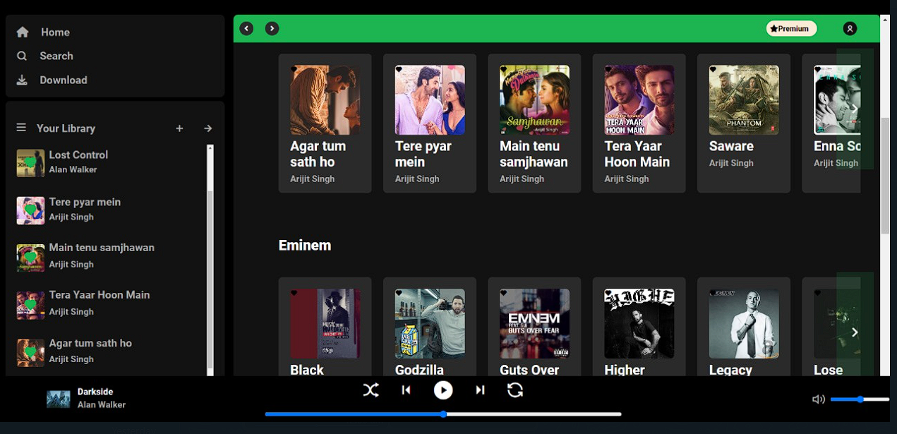
Screenshots

Slide 8
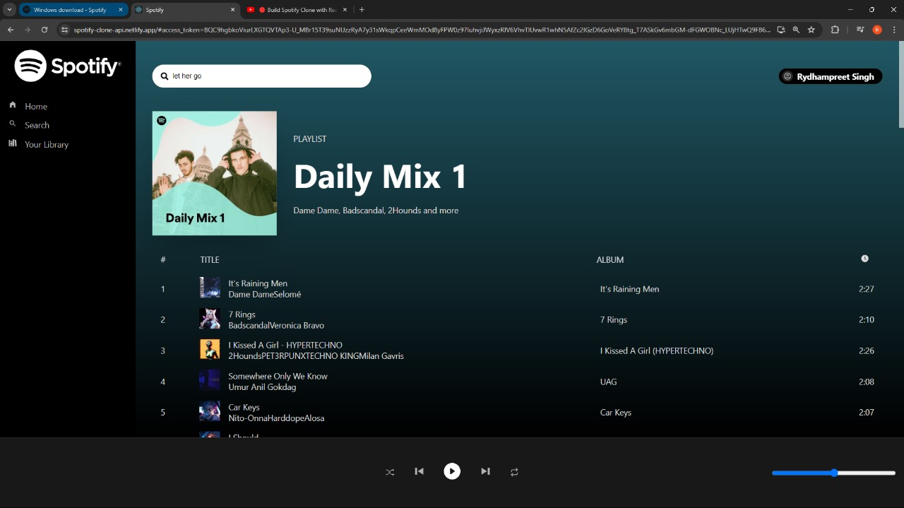
Screenshots

Slide 9
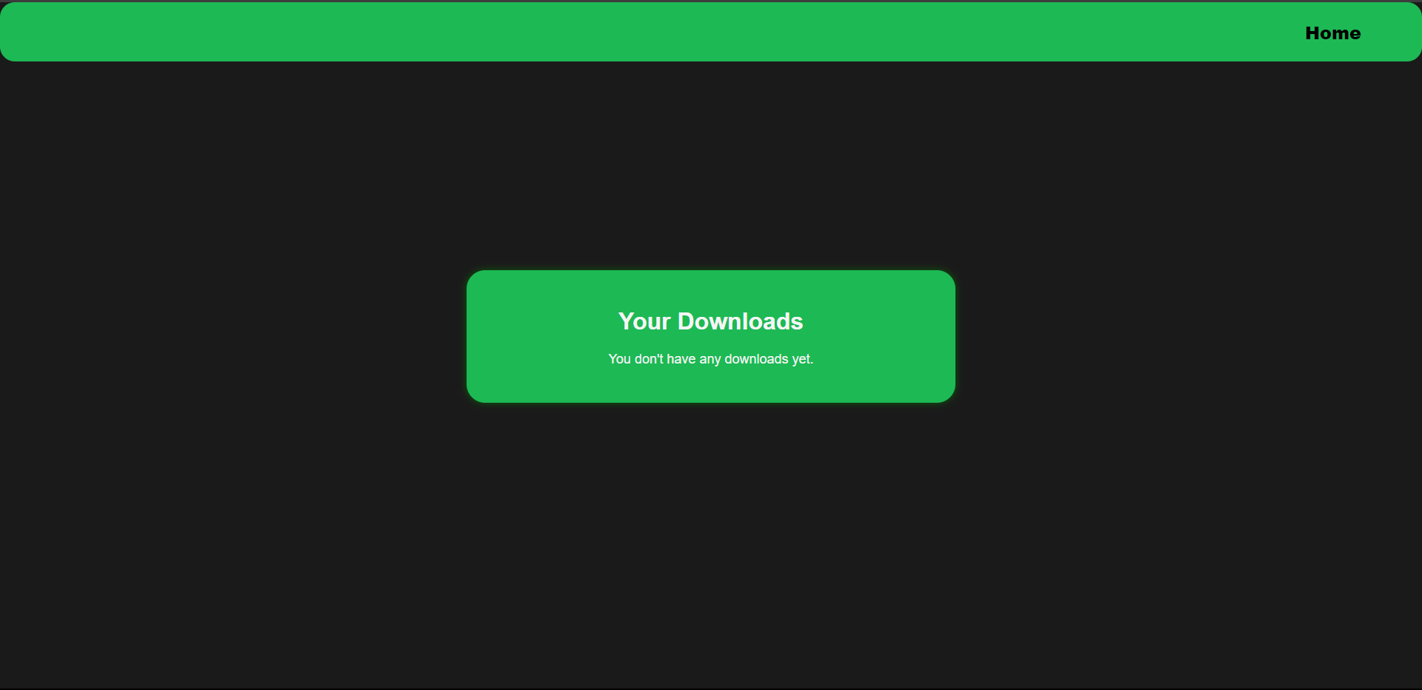
Screenshots

Slide 10
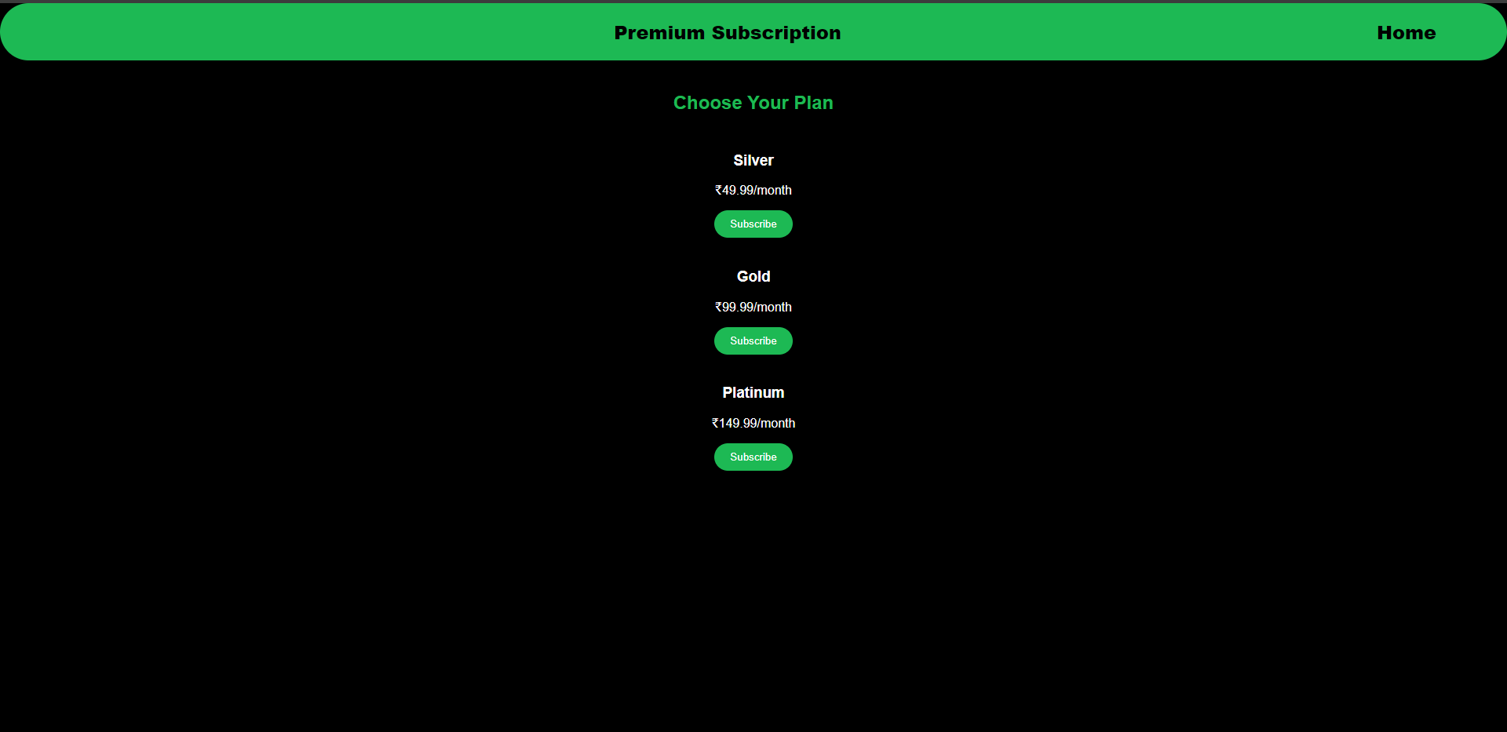
Screenshots

Slide 11
Conclusion
Our Music Player project showcases teamwork, creativity, and technical skills. Using ReactJS, HTML, CSS, and JavaScript, we've built a dynamic, user-friendly app with core music streaming functionalities. It's improved our frontend development and collaborative engineering practices. Moving ahead, we plan to refine and expand the app while exploring new web development technologies.

Slide 12
References/Links used
W3schools:- https://www.w3schools.com/
YouTube:- https://www.youtube.com/
GitHub:- https://github.com/
Spotify Api :- https://developer.spotify.com/documen...

Slide 13


